Slide 1
GNNs for Recommender Systems

Slide 2
Overview
Introduction to recommender systems
Neural graph collaborative filtering (NGCF)
LightGCN
Model training

Slide 3
Introduction to recommender systems

Slide 4




What is a recommendation system?
Typically, includes users and items
Items can be anything: media content, clothing, websites, medications, …
Goal is to recommend new items to users that they are likely to ”consume” (i.e., watch, read, buy, click on, …)
Approaches generally seek to:
Identify users similar to current user and recommend items consumed by the similar users
And/OR: identify similar items to those the current user has previously “consumed”

Slide 5
Why do we need recommendation systems?
Information deluge and “choice” overload
>10K movies on Netflix
>12M products on Amazon
>70M music tracks on Spotify
>10B videos on YouTube
>200B pins on Pinterest
Personalized recommendation (i.e., suggesting a small number of items that are likely to be interesting to the user) is critical

Slide 6
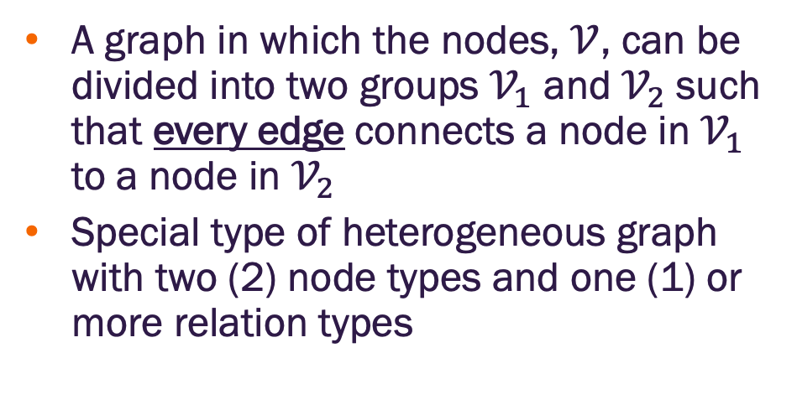
Bipartite graph
A graph in which the nodes, $𝒱$, can be divided into two groups $𝒱_{1}$ and $𝒱_{2}$ such that every edge connects a node in $𝒱_{1}$ to a node in $𝒱_{2}$
Special type of heterogeneous graph with two (2) node types and one (1) or more relation types
All edges in a bipartite graph are between nodes of two distinct types

Slide 7
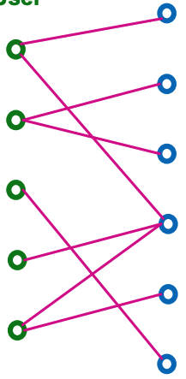
Recommender system as a graph
Items
Users
A recommender system can be modelled as a bipartite graph
Node types
Users
Items
Edges connect users to items
Indicates a user-item interaction (e.g., purchase, view, etc)
Typically associated with a timestamp
User-Item Interactions
Image credit: Jure Leskovec, http://cs224w.stanford.edu

Slide 8
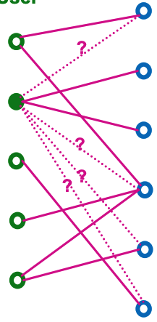
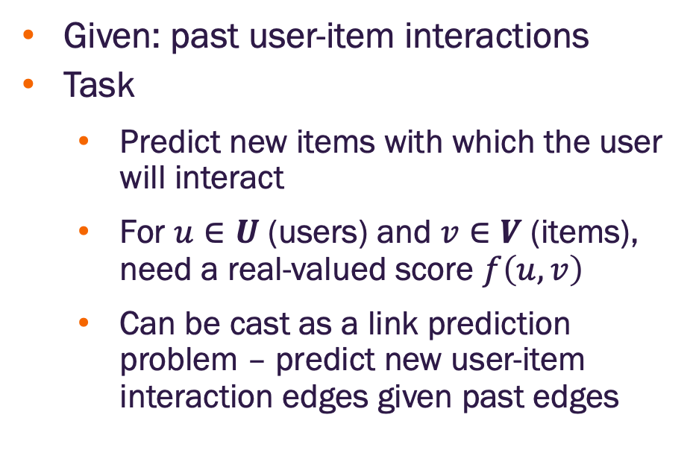
Recommendation task
Items
Users
Given: past user-item interactions
Task
Predict new items with which the user will interact
For $u∈U$ (users) and $v∈V$ (items), need a real-valued score $f\left(u, v\right)$
Can be cast as a link prediction problem – predict new user-item interaction edges given past edges
User-Item Interactions
Image credit: Jure Leskovec, http://cs224w.stanford.edu

Slide 9
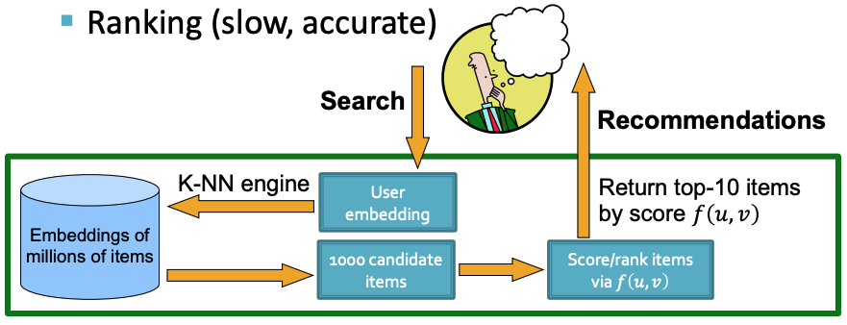
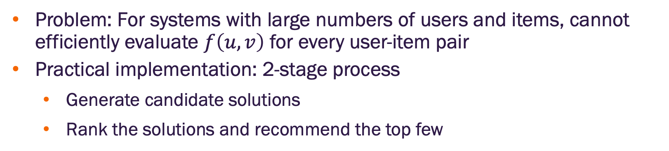
Recommender systems at scale
Problem: For systems with large numbers of users and items, cannot efficiently evaluate $f\left(u, v\right)$ for every user-item pair
Practical implementation: 2-stage process
Generate candidate solutions
Rank the solutions and recommend the top few
Image credit: Jure Leskovec, http://cs224w.stanford.edu

Slide 10
Top-K recommendations
For each user, recommend K items
To be effective, K needs to be much smaller than the total number of items available
K is typically 10– 100
The goal is to include as many positive items as possible in the top-K recommended items where
Positive item → one with which the user will interact
Evaluation metric: Recall@K

Slide 11
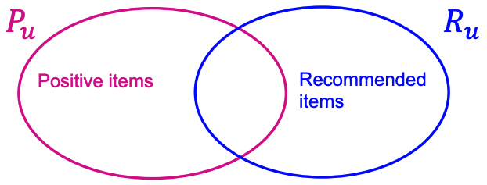
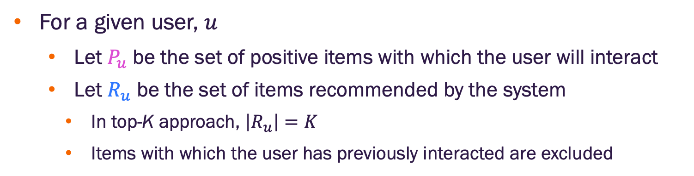
Recall@K metric
For a given user, $u$
Let $P_{u}$ be the set of positive items with which the user will interact
Let $R_{u}$ be the set of items recommended by the system
In top-K approach, $\left|R_{u}\right|=K$
Items with which the user has previously interacted are excluded
Image credit: Jure Leskovec, http://cs224w.stanford.edu

Slide 12
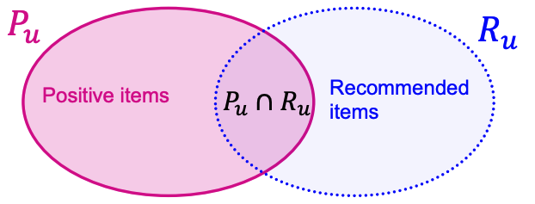
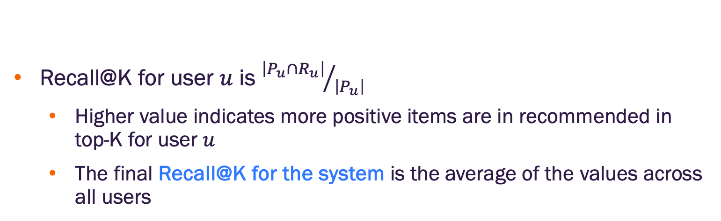
Recall@K metric
Recall@K for user $u$ is ${\left|P_{u}∩R_{u}\right|}/{\left|P_{u}\right|}$
Higher value indicates more positive items are in recommended in top-K for user $u$
The final Recall@K for the system is the average of the values across all users
Image credit: Jure Leskovec, http://cs224w.stanford.edu

Slide 13
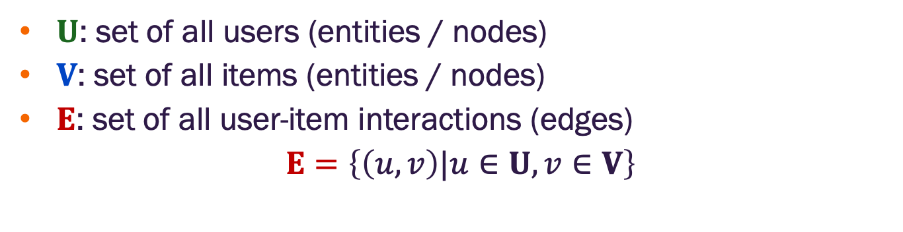
Notation
$U$: set of all users (entities / nodes)
$V$: set of all items (entities / nodes)
$E$: set of all user-item interactions (edges)
$$E=\left\{\left(u,v\right)|u∈U, v∈V\right\}$$

Slide 14
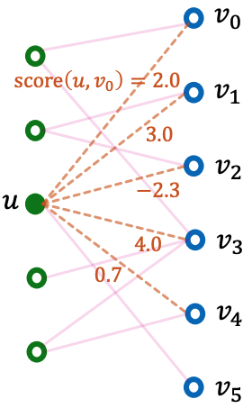
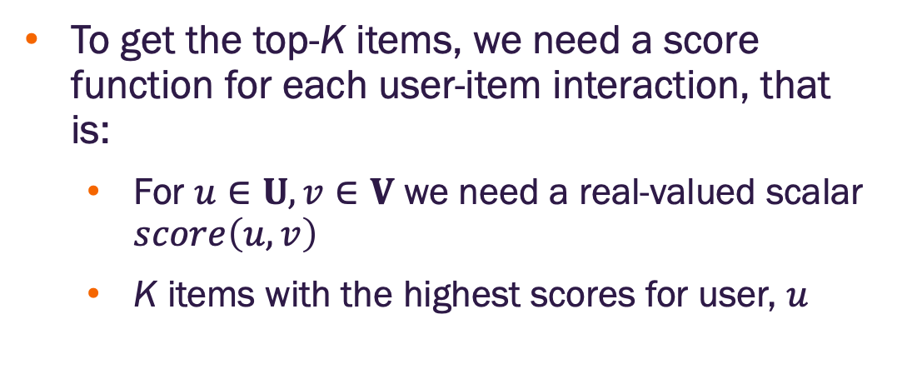
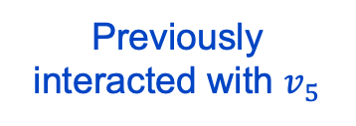
Score function
Items
Users
To get the top-K items, we need a score function for each user-item interaction, that is:
For $u∈U, v∈V$ we need a real-valued scalar $score\left(u,v\right)$
K items with the highest scores for user, $u$
Previously interacted with $v_{5}$
Image credit: Jure Leskovec, http://cs224w.stanford.edu

Slide 15
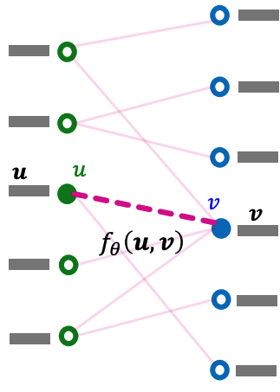
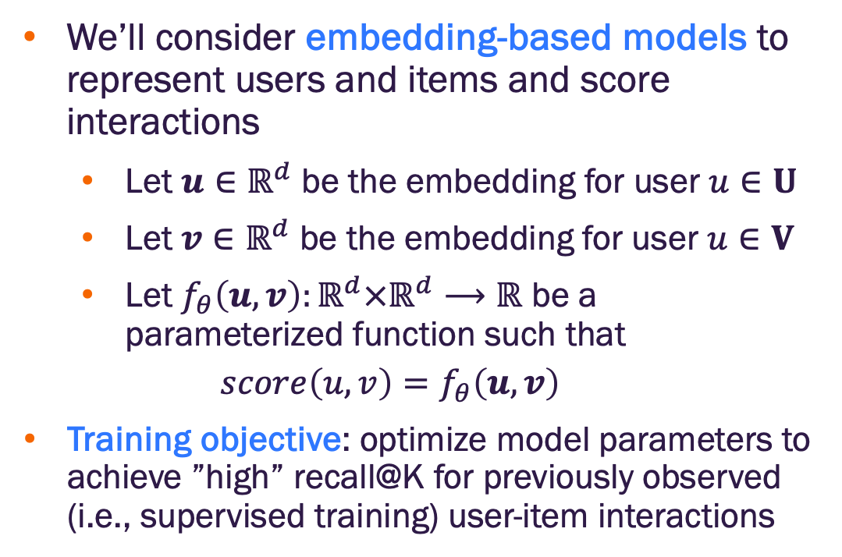
Embedding based models
We’ll consider embedding-based models to represent users and items and score interactions
Let $u∈ℝ^{d}$ be the embedding for user $u∈U$
Let $v∈ℝ^{d}$ be the embedding for user $u∈V$
Let $f_{θ}\left(u,v\right):ℝ^{d}×ℝ^{d}⟶ℝ$ be a parameterized function such that
$$score\left(u,v\right)=f_{θ}\left(u,v\right)$$
Training objective: optimize model parameters to achieve ”high” recall@K for previously observed (i.e., supervised training) user-item interactions
Items
Users
Image credit: Jure Leskovec, http://cs224w.stanford.edu

Slide 16
Neural graph collaborative filtering

Slide 17
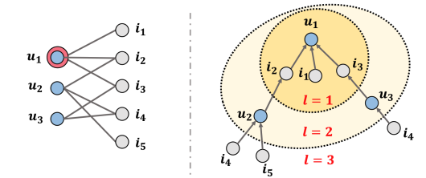
Neural graph collaborative filtering (NGCF)
Incorporate high-order graph structure when generating user / item embeddings
Use a GNN to generate user / item embeddings
Image credit: Wang et al., 2019

Slide 18
Neural graph collaborative filtering (NGCF)
Given: user-item bipartite graph
NGCF framework
Randomly initialize embeddings for each user & item node
Use multi-layer GNN to propagate messages along the bipartite graph to update embeddings
Final embeddings are explicitly aware of the graph structure (higher order interactions of users & items)
Two types of learnable parameters
Initial user / item embeddings (this is different than what we’ve done previously)
GNN parameters
Image credit: Wang et al., 2019

Slide 19
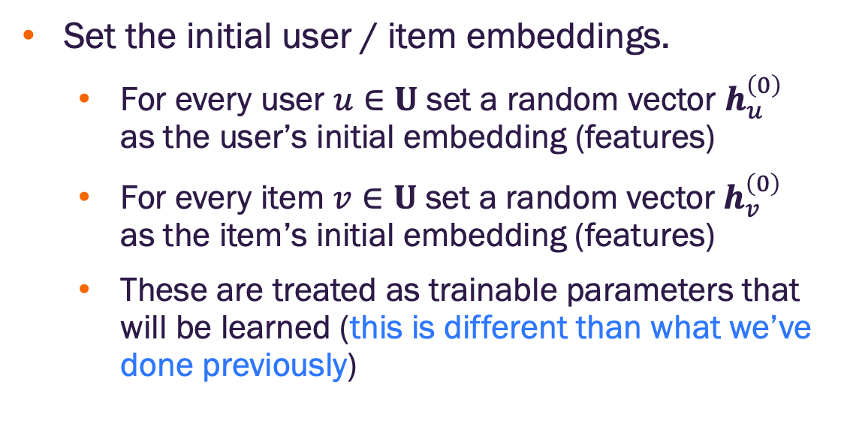
Neural graph collaborative filtering (NGCF)
Set the initial user / item embeddings.
For every user $u∈U$ set a random vector $h_{u}^{\left(0\right)}$ as the user’s initial embedding (features)
For every item $v∈U$ set a random vector $h_{v}^{\left(0\right)}$ as the item’s initial embedding (features)
These are treated as trainable parameters that will be learned (this is different than what we’ve done previously)
Image credit: Wang et al., 2019

Slide 20
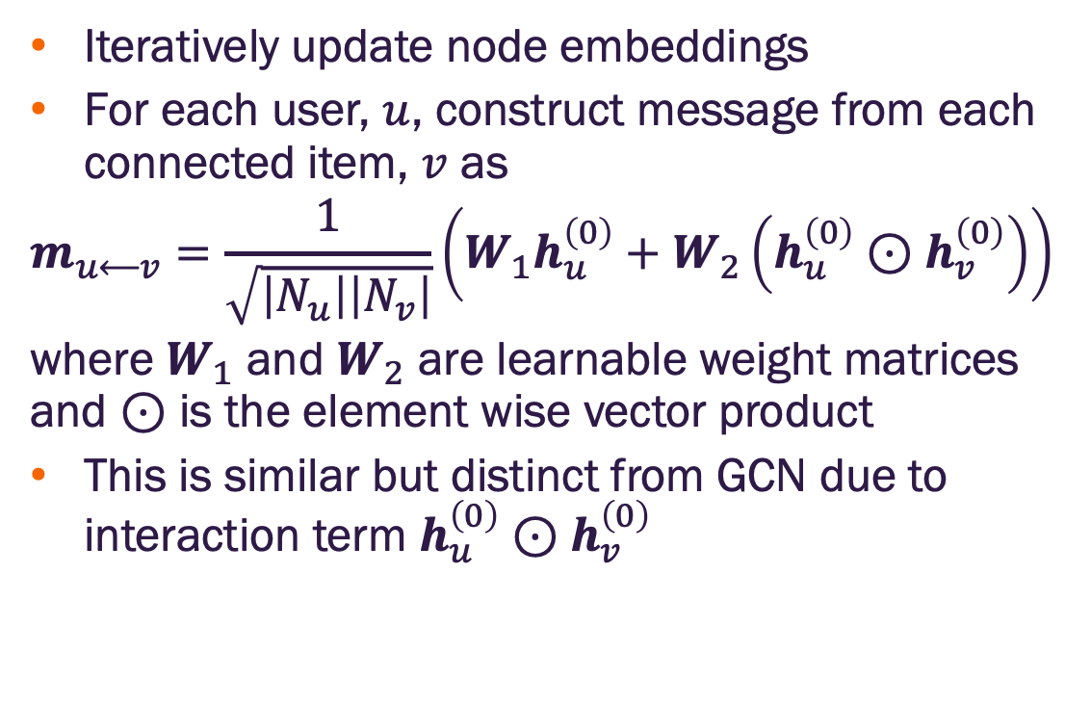
Neural graph collaborative filtering (NGCF)
Iteratively update node embeddings
For each user, $u$, construct message from each connected item, $v$ as
$$m_{u⟵v}=\frac{1}{\sqrt{\left|N_{u}\right|\left|N_{v}\right|}}\left(W_{1}h_{u}^{\left(0\right)}+W_{2}\left(h_{u}^{\left(0\right)}⊙h_{v}^{\left(0\right)}\right)\right)$$
where $W_{1}$ and $W_{2}$ are learnable weight matrices and $⊙$ is the element wise vector product
This is similar but distinct from GCN due to interaction term $h_{u}^{\left(0\right)}⊙h_{v}^{\left(0\right)}$
Image credit: Wang et al., 2019

Slide 21
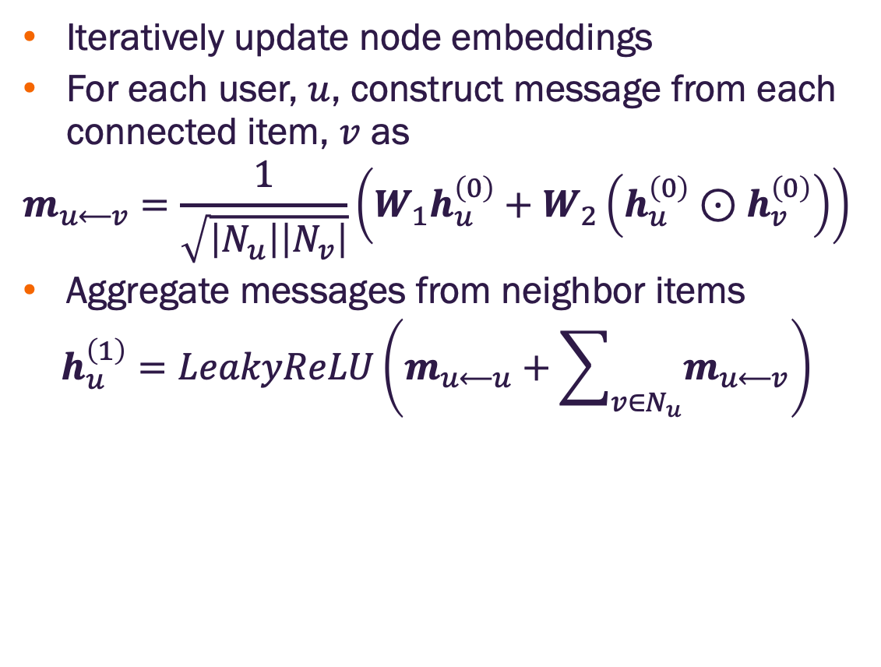
Neural graph collaborative filtering (NGCF)
Iteratively update node embeddings
For each user, $u$, construct message from each connected item, $v$ as
$$m_{u⟵v}=\frac{1}{\sqrt{\left|N_{u}\right|\left|N_{v}\right|}}\left(W_{1}h_{u}^{\left(0\right)}+W_{2}\left(h_{u}^{\left(0\right)}⊙h_{v}^{\left(0\right)}\right)\right)$$
Aggregate messages from neighbor items
$$h_{u}^{\left(1\right)}=LeakyReLU\left(m_{u⟵u}+\sum_{v∈N_{u}}{m_{u⟵v}}\right)$$
Image credit: Wang et al., 2019

Slide 22
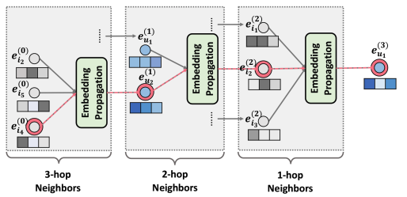
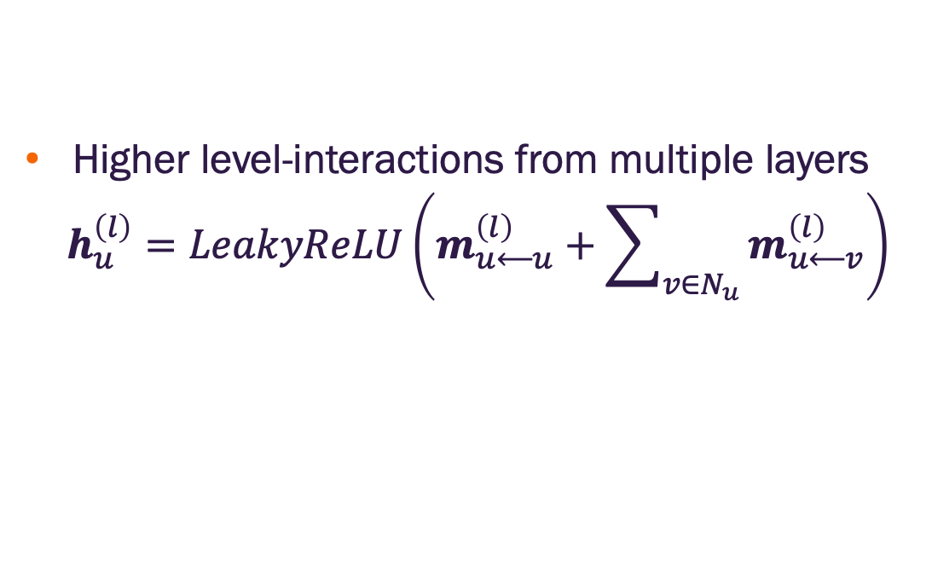
Neural graph collaborative filtering (NGCF)
Higher level-interactions from multiple layers
$$h_{u}^{\left(l\right)}=LeakyReLU\left(m_{u⟵u}^{\left(l\right)}+\sum_{v∈N_{u}}{m_{u⟵v}^{\left(l\right)}}\right)$$
Image credit: Wang et al., 2019

Slide 23
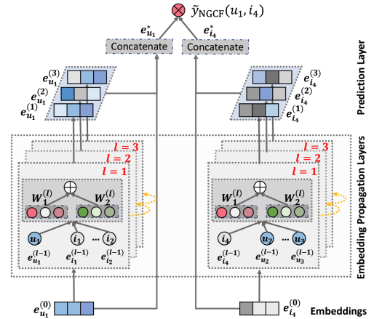
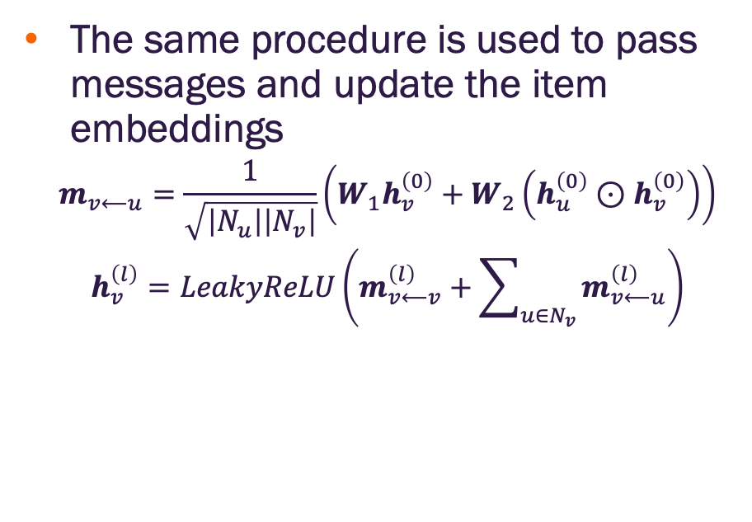
Neural graph collaborative filtering (NGCF)
The same procedure is used to pass messages and update the item embeddings
$$m_{v⟵u}=\frac{1}{\sqrt{\left|N_{u}\right|\left|N_{v}\right|}}\left(W_{1}h_{v}^{\left(0\right)}+W_{2}\left(h_{u}^{\left(0\right)}⊙h_{v}^{\left(0\right)}\right)\right)$$
$$h_{v}^{\left(l\right)}=LeakyReLU\left(m_{v⟵v}^{\left(l\right)}+\sum_{u∈N_{v}}{m_{v⟵u}^{\left(l\right)}}\right)$$
Image credit: Wang et al., 2019

Slide 24
LightGCN

Slide 25
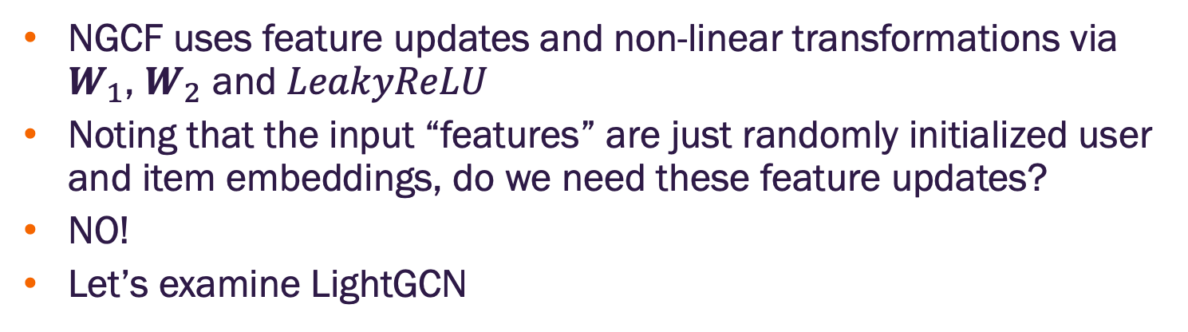
Is the complexity of NGCF necessary?
NGCF uses feature updates and non-linear transformations via $W_{1}$, $W_{2}$ and $LeakyReLU$
Noting that the input “features” are just randomly initialized user and item embeddings, do we need these feature updates?
NO!
Let’s examine LightGCN

Slide 26
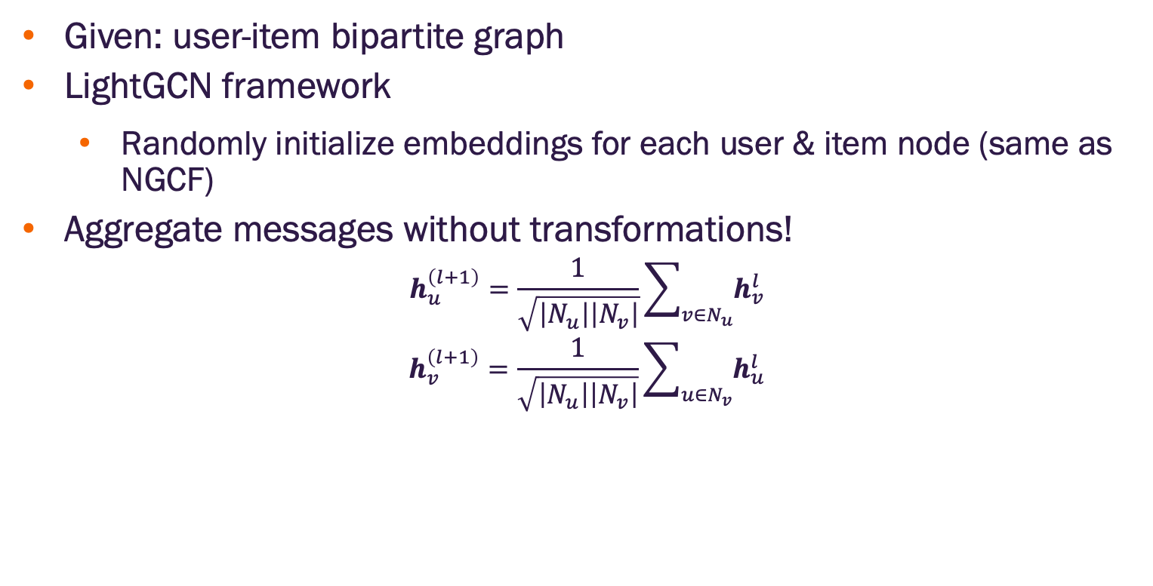
Light graph convolution network (LightGCN)
Given: user-item bipartite graph
LightGCN framework
Randomly initialize embeddings for each user & item node (same as NGCF)
Aggregate messages without transformations!
$$h_{u}^{\left(l+1\right)}=\frac{1}{\sqrt{\left|N_{u}\right|\left|N_{v}\right|}}\sum_{v∈N_{u}}{h_{v}^{l}}$$
$$h_{v}^{\left(l+1\right)}=\frac{1}{\sqrt{\left|N_{u}\right|\left|N_{v}\right|}}\sum_{u∈N_{v}}{h_{u}^{l}}$$
User embeddings
Item embeddings

Slide 27
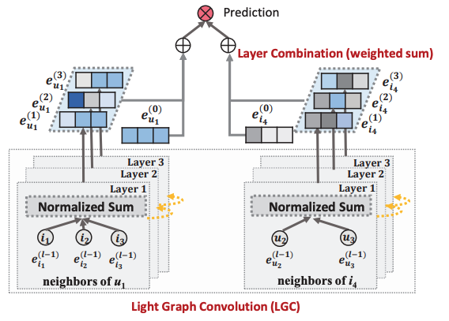
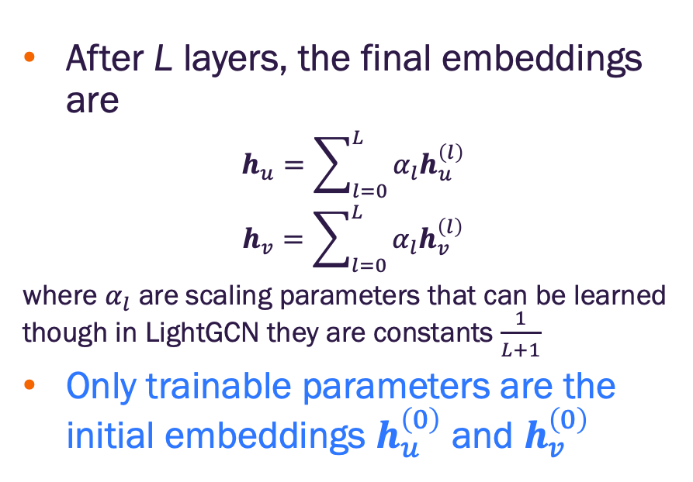
Light graph convolution network (LightGCN)
After L layers, the final embeddings are
$$h_{u}=\sum_{l=0}^{L}{α_{l}h_{u}^{\left(l\right)}}$$
$$h_{v}=\sum_{l=0}^{L}{α_{l}h_{v}^{\left(l\right)}}$$
where $α_{l}$ are scaling parameters that can be learned though in LightGCN they are constants $\frac{1}{L+1}$
Only trainable parameters are the initial embeddings $h_{u}^{\left(0\right)}$ and $h_{v}^{\left(0\right)}$
User embeddings
Item embeddings

Slide 28
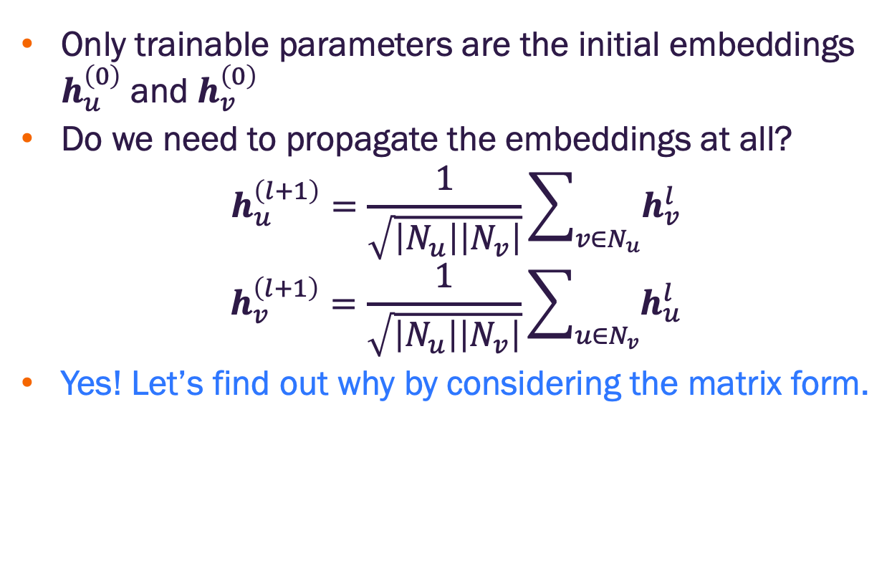
Light graph convolution network (LightGCN)
Only trainable parameters are the initial embeddings $h_{u}^{\left(0\right)}$ and $h_{v}^{\left(0\right)}$
Do we need to propagate the embeddings at all?
$$h_{u}^{\left(l+1\right)}=\frac{1}{\sqrt{\left|N_{u}\right|\left|N_{v}\right|}}\sum_{v∈N_{u}}{h_{v}^{l}}$$
$$h_{v}^{\left(l+1\right)}=\frac{1}{\sqrt{\left|N_{u}\right|\left|N_{v}\right|}}\sum_{u∈N_{v}}{h_{u}^{l}}$$
Yes! Let’s find out why by considering the matrix form.

Slide 29
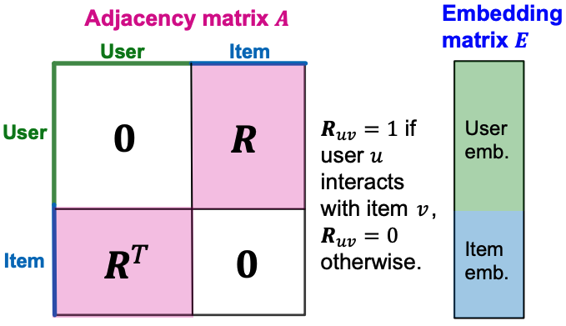
Light graph convolution network (LightGCN)
We can write the adjacency matrix of an undirected bipartite graph as a block antidiagonal matrix
We can combine the initial (random) user and item embeddings in a single matrix
Image credit: Jure Leskovec, http://cs224w.stanford.edu

Slide 30
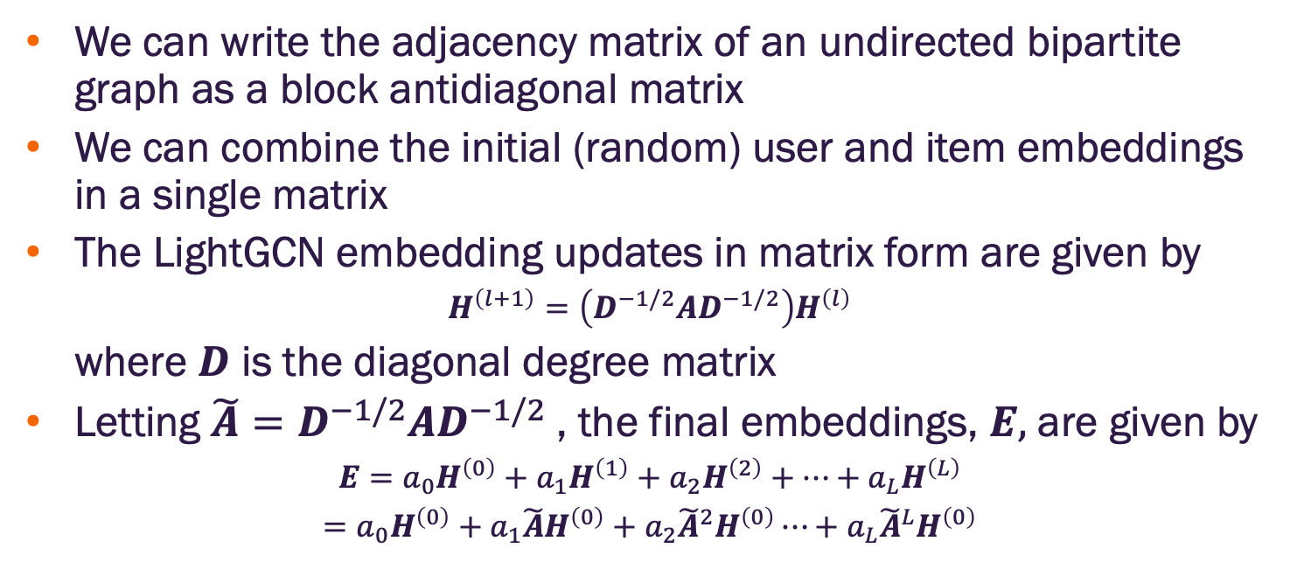
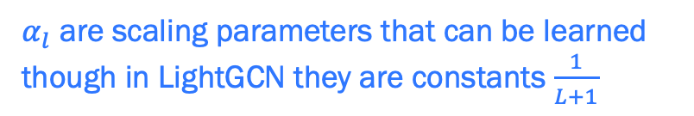
Light graph convolution network (LightGCN)
We can write the adjacency matrix of an undirected bipartite graph as a block antidiagonal matrix
We can combine the initial (random) user and item embeddings in a single matrix
The LightGCN embedding updates in matrix form are given by
$$H^{\left(l+1\right)}=\left(D^{−1/2}AD^{−1/2}\right)H^{\left(l\right)}$$
where $D$ is the diagonal degree matrix
Letting $\tilde{A}=D^{−1/2}AD^{−1/2}$, the final embeddings, $E,$ are given by
$$E=a_{0}H^{\left(0\right)}+a_{1}H^{\left(1\right)}+a_{2}H^{\left(2\right)}+⋯+a_{L}H^{\left(L\right)}$$
$$=a_{0}H^{\left(0\right)}+a_{1}\tilde{A}H^{\left(0\right)}+a_{2}{\tilde{A}}^{2}H^{\left(0\right)}⋯+a_{L}{\tilde{A}}^{L}H^{\left(0\right)}$$
$α_{l}$ are scaling parameters that can be learned though in LightGCN they are constants $\frac{1}{L+1}$
Image credit: Jure Leskovec, http://cs224w.stanford.edu

Slide 31
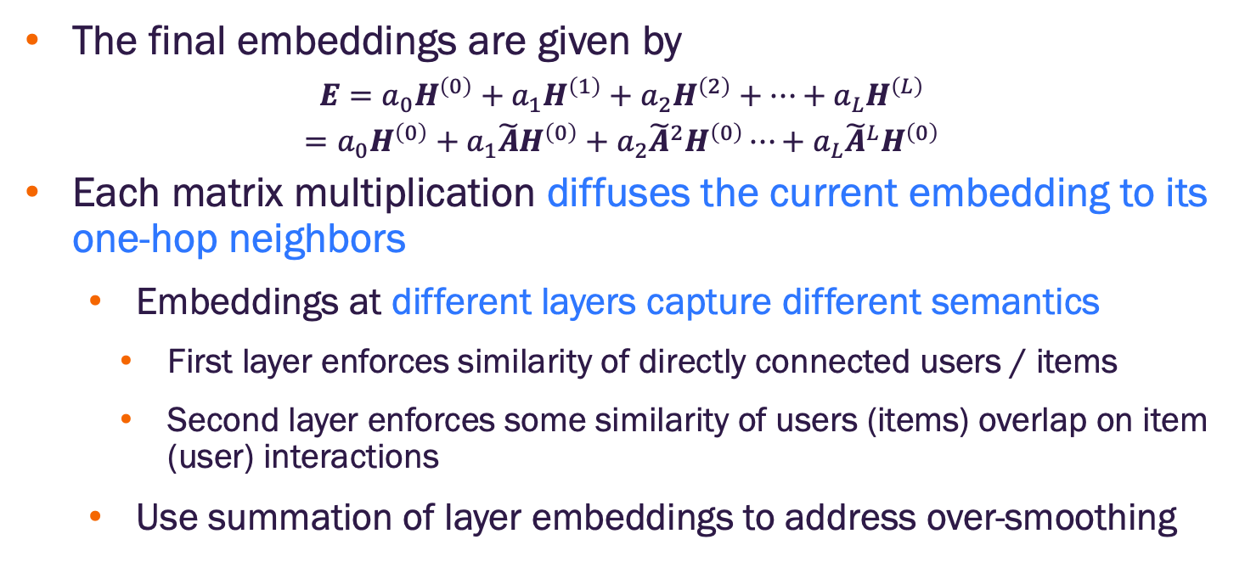
Light graph convolution network (LightGCN)
The final embeddings are given by
$$E=a_{0}H^{\left(0\right)}+a_{1}H^{\left(1\right)}+a_{2}H^{\left(2\right)}+⋯+a_{L}H^{\left(L\right)}$$
$$=a_{0}H^{\left(0\right)}+a_{1}\tilde{A}H^{\left(0\right)}+a_{2}{\tilde{A}}^{2}H^{\left(0\right)}⋯+a_{L}{\tilde{A}}^{L}H^{\left(0\right)}$$
Each matrix multiplication diffuses the current embedding to its one-hop neighbors
Embeddings at different layers capture different semantics
First layer enforces similarity of directly connected users / items
Second layer enforces some similarity of users (items) overlap on item (user) interactions
Use summation of layer embeddings to address over-smoothing
$α_{l}$ are scaling parameters that can be learned though in LightGCN they are constants $\frac{1}{L+1}$
Image credit: Jure Leskovec, http://cs224w.stanford.edu

Slide 32
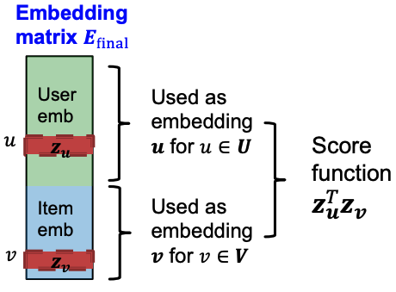
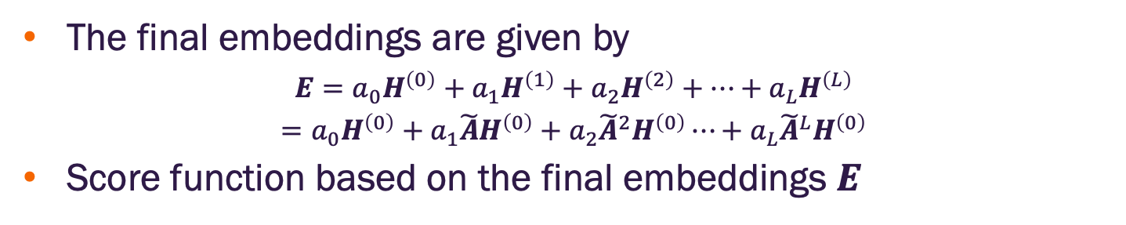
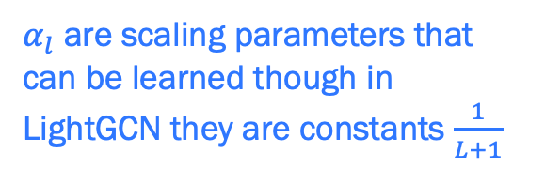
Light graph convolution network (LightGCN)
The final embeddings are given by
$$E=a_{0}H^{\left(0\right)}+a_{1}H^{\left(1\right)}+a_{2}H^{\left(2\right)}+⋯+a_{L}H^{\left(L\right)}$$
$$=a_{0}H^{\left(0\right)}+a_{1}\tilde{A}H^{\left(0\right)}+a_{2}{\tilde{A}}^{2}H^{\left(0\right)}⋯+a_{L}{\tilde{A}}^{L}H^{\left(0\right)}$$
Score function based on the final embeddings $E$
$α_{l}$ are scaling parameters that can be learned though in LightGCN they are constants $\frac{1}{L+1}$
Image credit: Jure Leskovec, http://cs224w.stanford.edu

Slide 33
Model training
Our training objective (recall@K) is not differentiable
Cannot apply gradient-based optimization
Two alternative loss functions are used to address this
Binary loss
Bayesian personalized rankings (BPR) loss
Both alternatives align well with the original training objective though BPR is typically preferred (let’s see why)

Slide 34
NGCF & LightGCN Training

Slide 35
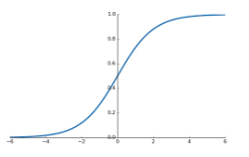
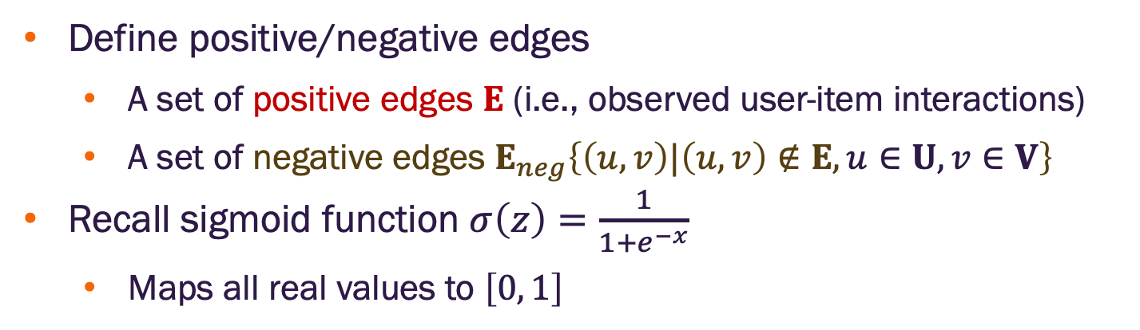
Binary loss
Define positive/negative edges
A set of positive edges $E$ (i.e., observed user-item interactions)
A set of negative edges $E_{neg}\left\{\left(u,v\right)|\left(u,v\right)∉E,u∈U, v∈V\right\}$
Recall sigmoid function $σ\left(z\right)=\frac{1}{1+e^{−x}}$
Maps all real values to $\left[0, 1\right]$

Slide 36
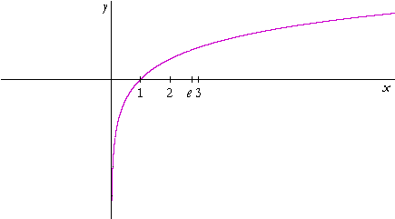
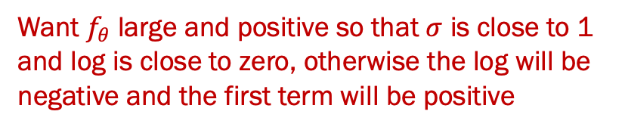
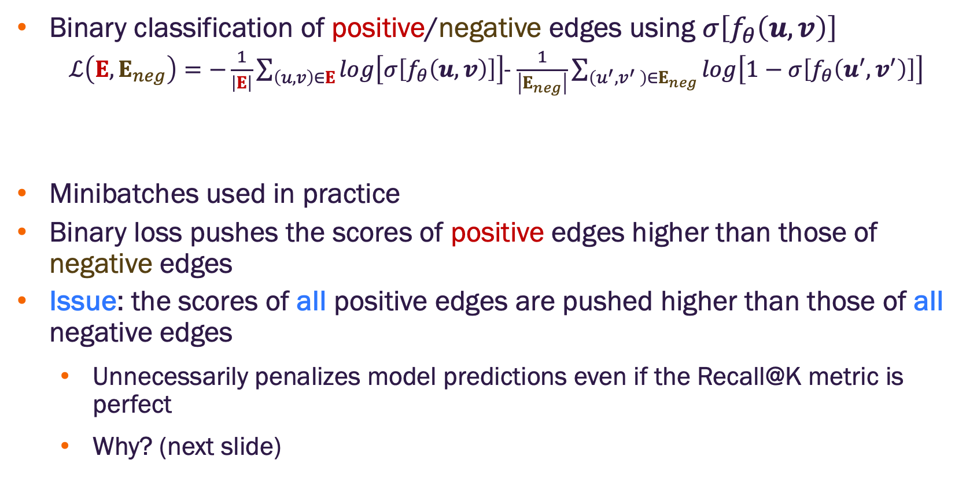
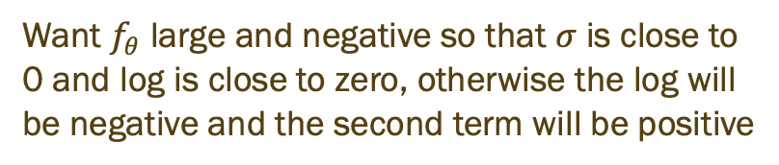
Binary loss
Binary classification of positive/negative edges using $σ\left[f_{θ}\left(u,v\right)\right]$
$ℒ\left(E,E_{neg}\right)=−\frac{1}{\left|E\right|}\sum_{\left(u,v\right)∈E}{log\left[σ\left[f_{θ}\left(u,v\right)\right]\right]}$- $\frac{1}{\left|E_{neg}\right|}\sum_{\left(u^{′},v^{′} \right)∈E_{neg}}{log\left[1−σ\left[f_{θ}\left(u^{′},v^{′}\right)\right]\right]}$
Minibatches used in practice
Binary loss pushes the scores of positive edges higher than those of negative edges
Issue: the scores of all positive edges are pushed higher than those of all negative edges
Unnecessarily penalizes model predictions even if the Recall@K metric is perfect
Why? (next slide)
Want $f_{θ}$ large and positive so that $σ$ is close to 1 and log is close to zero, otherwise the log will be negative and the first term will be positive
Want $f_{θ}$ large and negative so that $σ$ is close to 0 and log is close to zero, otherwise the log will be negative and the second term will be positive

Slide 37
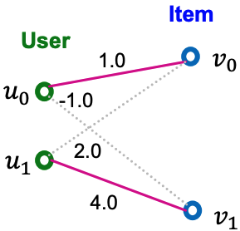
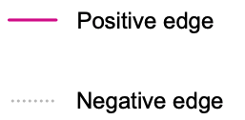
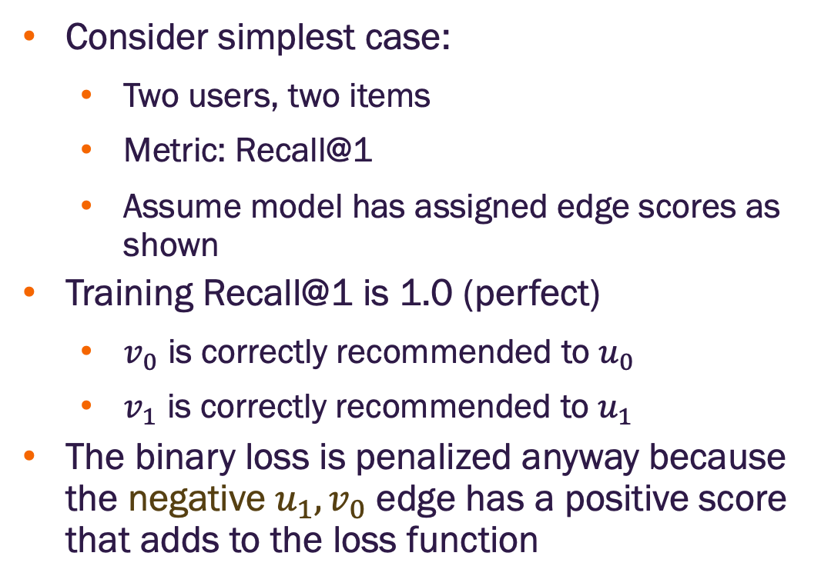
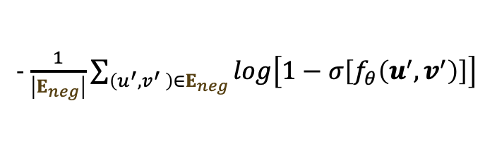
Binary loss
Consider simplest case:
Two users, two items
Metric: Recall@1
Assume model has assigned edge scores as shown
Training Recall@1 is 1.0 (perfect)
$v_{0}$ is correctly recommended to $u_{0}$
$v_{1}$ is correctly recommended to $u_{1}$
The binary loss is penalized anyway because the negative $u_{1},v_{0}$ edge has a positive score that adds to the loss function
- $\frac{1}{\left|E_{neg}\right|}\sum_{\left(u^{′},v^{′} \right)∈E_{neg}}{log\left[1−σ\left[f_{θ}\left(u^{′},v^{′}\right)\right]\right]}$
Image credit: Jure Leskovec, http://cs224w.stanford.edu

Slide 38
Binary loss
The binary loss is not personalized in the sense that the positive/negative edges are considered across all users simultaneously
The Recall@K metric is inherently personalized
The binary loss is overly stringent for personalized recommendation
Bayesian personalized ranking (BPR) loss will address this

Slide 39
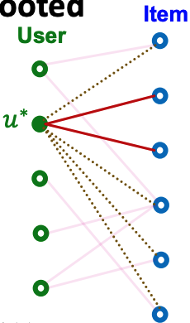
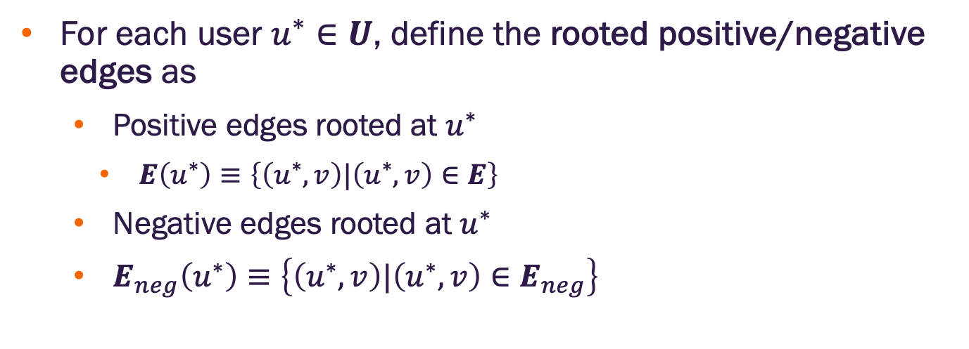
Bayesian personalized ranking (BPR) loss
For each user $u^{∗}∈U$, define the rooted positive/negative edges as
Positive edges rooted at $u^{∗}$
$E\left(u^{∗}\right)≡\left\{\left(u^{∗},v\right)|\left(u^{∗},v\right)∈E\right\}$
Negative edges rooted at $u^{∗}$
$E_{neg}\left(u^{∗}\right)≡\left\{\left(u^{∗},v\right)|\left(u^{∗},v\right)∈E_{neg}\right\}$
Image credit: Jure Leskovec, http://cs224w.stanford.edu

Slide 40
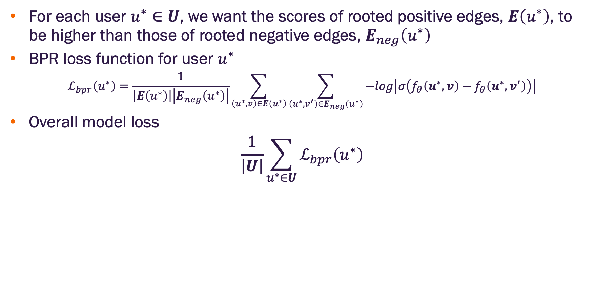
Bayesian personalized ranking (BPR) loss
For each user $u^{∗}∈U$, we want the scores of rooted positive edges, $E\left(u^{∗}\right)$, to be higher than those of rooted negative edges, $E_{neg}\left(u^{∗}\right)$
BPR loss function for user $u^{∗}$
$$ℒ_{bpr}\left(u^{∗}\right)=\frac{1}{\left|E\left(u^{∗}\right)\right|\left|E_{neg}\left(u^{∗}\right)\right|}\sum_{\left(u^{∗},v\right)∈E\left(u^{∗}\right)}{\sum_{\left(u^{∗},v^{′}\right)∈E_{neg}\left(u^{∗}\right)}{−log\left[σ\left(f_{θ}\left(u^{∗},v\right)−f_{θ}\left(u^{∗},v^{′}\right)\right)\right]}}$$
Overall model loss
$$\frac{1}{\left|U\right|}\sum_{u^{∗}∈U}{ℒ_{bpr}\left(u^{∗}\right)}$$
Image credit: Jure Leskovec, http://cs224w.stanford.edu

Slide 41
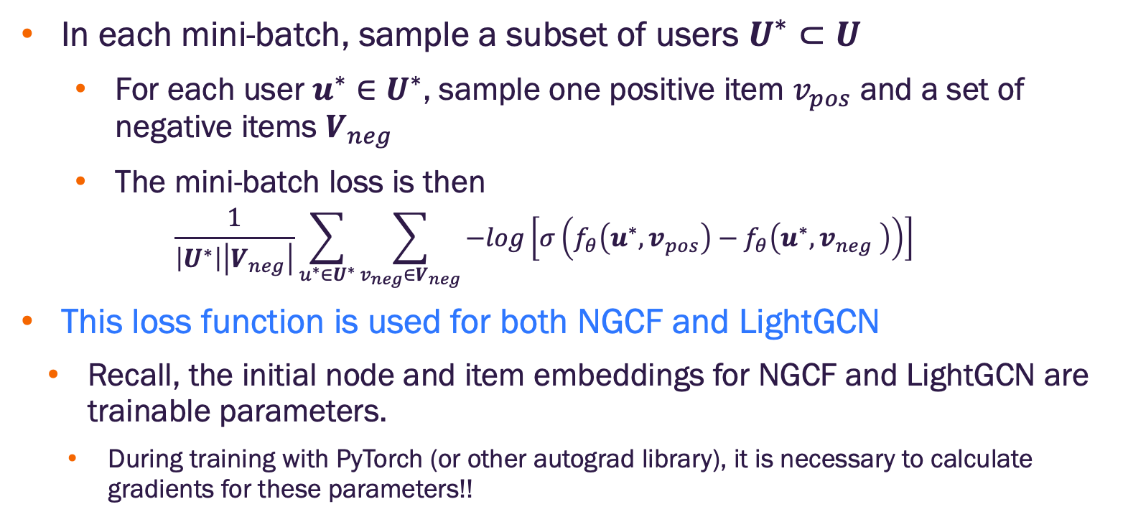
Mini-batch training with BPR loss
In each mini-batch, sample a subset of users $U^{∗}⊂U$
For each user ${u^{∗}∈U}^{∗}$, sample one positive item $v_{pos}$ and a set of negative items $V_{neg}$
The mini-batch loss is then
$$\frac{1}{\left|U^{∗}\right|\left|V_{neg}\right|}\sum_{u^{∗}∈U^{∗}}{\sum_{v_{neg}∈V_{neg}}{−log\left[σ\left(f_{θ}\left(u^{∗}, v_{pos}\right)−f_{θ}\left(u^{∗},v_{neg} \right)\right)\right]}}$$
This loss function is used for both NGCF and LightGCN
Recall, the initial node and item embeddings for NGCF and LightGCN are trainable parameters.
During training with PyTorch (or other autograd library), it is necessary to calculate gradients for these parameters!!

Slide 42

Evaluation with Hits@K
May not be convenient to calculate Recall@K
We don’t typically know $P_{u}$, the set of ALL items with which the user will interact
We may not need our system to identify all such items as long as it identifies enough as the top scored items
Hits@K
Set hits $h=0$, total test samples to $T$
For each user, $u$, with positive test item, $v$, calculate the score $s_{v}=f_{θ}\left(u,v\right)$
Randomly select $n−1$ items, $V^{∗}=\left\{v_{1},⋯,v_{n−1}\right\}$ among those for which $\left(u,v_{i}\right)∉E$ (i.e., user, $u$ does not interact with item $v_{i}$)
Score all items in $V^{∗}$ to obtain $S=\left\{s_{v}\right\}∪\left\{s_{v_{1}},⋯,s_{v_{n−1}}\right\}$
Sort $S$ in descending order
Find the rank (index) of $s_{v}$
If the rank of $s_{v}≤K$ set $h=h+1$
Repeat for all positive samples
hits@k =$k/T$

Slide 43


